Slide 1
TensorFlow Tools and Techniques
Joao Pereira
19354106
Notes:
Hey what is up, welcome to my lecture, I hope you all are having a great day. So to begin? I guess so

Slide 2

Hello!
I am Joao Pereira
I will be presenting TensorFLow Tools and Techniques and all of its wonder’s within this lecture.
Contact me at joao.pereira2@mail.dcu.ie
Notes:
To being, my name is Joao Pereira and it looks like I am presenting TensorFLow Tools and Techniques and all its glorious wonders to you all. If anyone has any questions regarding the topic, please feel free to contact me through the email provided on the slide!

Slide 3

What is ?
First of all what even is TensorFlow?
1

Slide 4


Open-source library for machine learning and artificial intelligence
TensorFlow’s primary focus is directed towards training and inference of ‘neural networks’. Primarily used for developing machine learning applications.

Slide 5
Neural Network?
Simplified models of brains used to recognize patterns
Decision Tree
Algorithm designed to map a set of inputs to a range of possible outputs.
Form of artificial intelligence consisting of groups of neurons
(just like the human brain) used to recognize patterns and clutter
by interpreting data and then classifying that information

Slide 6

Example of TensorFlow
Type something into the Google search
bar.
Notice that when you’re typing, Google
supplies you with autofill’s on what
you could be looking for?

Slide 7



Created by Google Brain
Released in 2015 under Apache License 2.0 in 2015
In 2019 it got the full release with the name of TensorFlow

Slide 8
How does work?
2

Slide 9
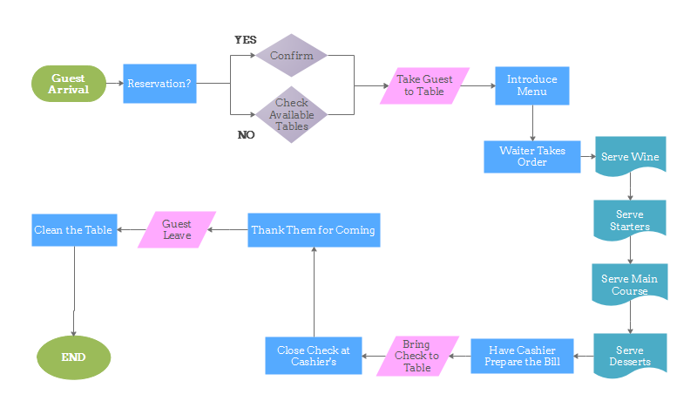
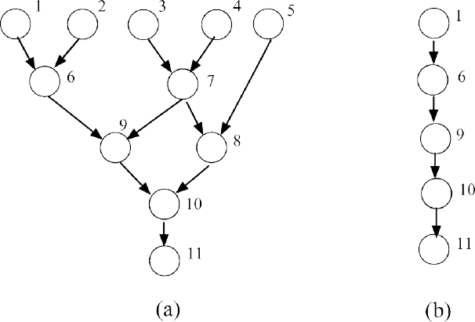


How it works:
Developers create Dataflow graphs
By accepting a multi-dimensional array called Tensor
Flow chart of operations
Developed in C++
Accessed and controlled by Python
Notes:
TensorFlow allows developers to create dataflow graphs to define how data moves through a graph, this is done by taking in inputs as a multi-dimensional array called Tensor. We’ll talk about Tensors in a second. By doing so, it then allows the developers to construct what is called a flow chart of operations that can be done on these inputs. The input goes in at one end and then flows through the system of multiple operations as an output on the other end.
Neural networking or so-called deep learning is reliant on a heavy usage of matrix multiplication. Tensorflow combats this issue by using C++ to compute the matrix multiplication. Although implemented by C++, It is controlled and accessed by Python. It makes use of Python to provide front-end API’s for creating apps and programs with the framework.

Slide 10
A tensor is a generalization of vectors and matrices and is easily understood as a multidimensional array. A vector is a one-dimensional or first-order tensor and a matrix is a two-dimensional or second-order tensor
- Introduction To Tensors for Machine Learning
Notes:
What is a Tensor? Here I mention a section within Introduction to Tensors for Machine Learning which I thought was highly useful in understanding the concept of Tensors. It goes by: A tensor is a generalization of vectors and matrices and is easily understood as a multidimensional array. A vector is a one-dimensional or first-order tensor and a matrix is a two-dimensional or second-order tensor.
Tensors are used within every computation of Tensorflow. Like the quote in this slide, they are a n-dimensional vector or matrix that represent all types of data. A tensor is created by the input data and each operation is referred to as an op node. The graph outlines the ops and connections between the nodes. However, it does not display the values. The edge of the nodes is the tensor. To further summarize, a tensor is consisted of a node and a edge. The node performs the mathematical operations and then provides endpoint outputs. Then the edges explain the input or output relationships between the nodes. Lastly Tensors are and nodes are Python objects.

Slide 11
Usage of Around the world
3

Slide 12















Famous applications currently using TensorFlow
Companies like Spotify, Airbnb, Chrome and PayPal rely a lot on TensorFlow to operate their most popular features

Slide 13

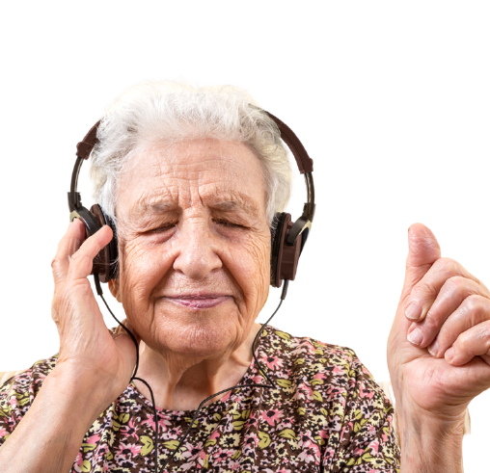
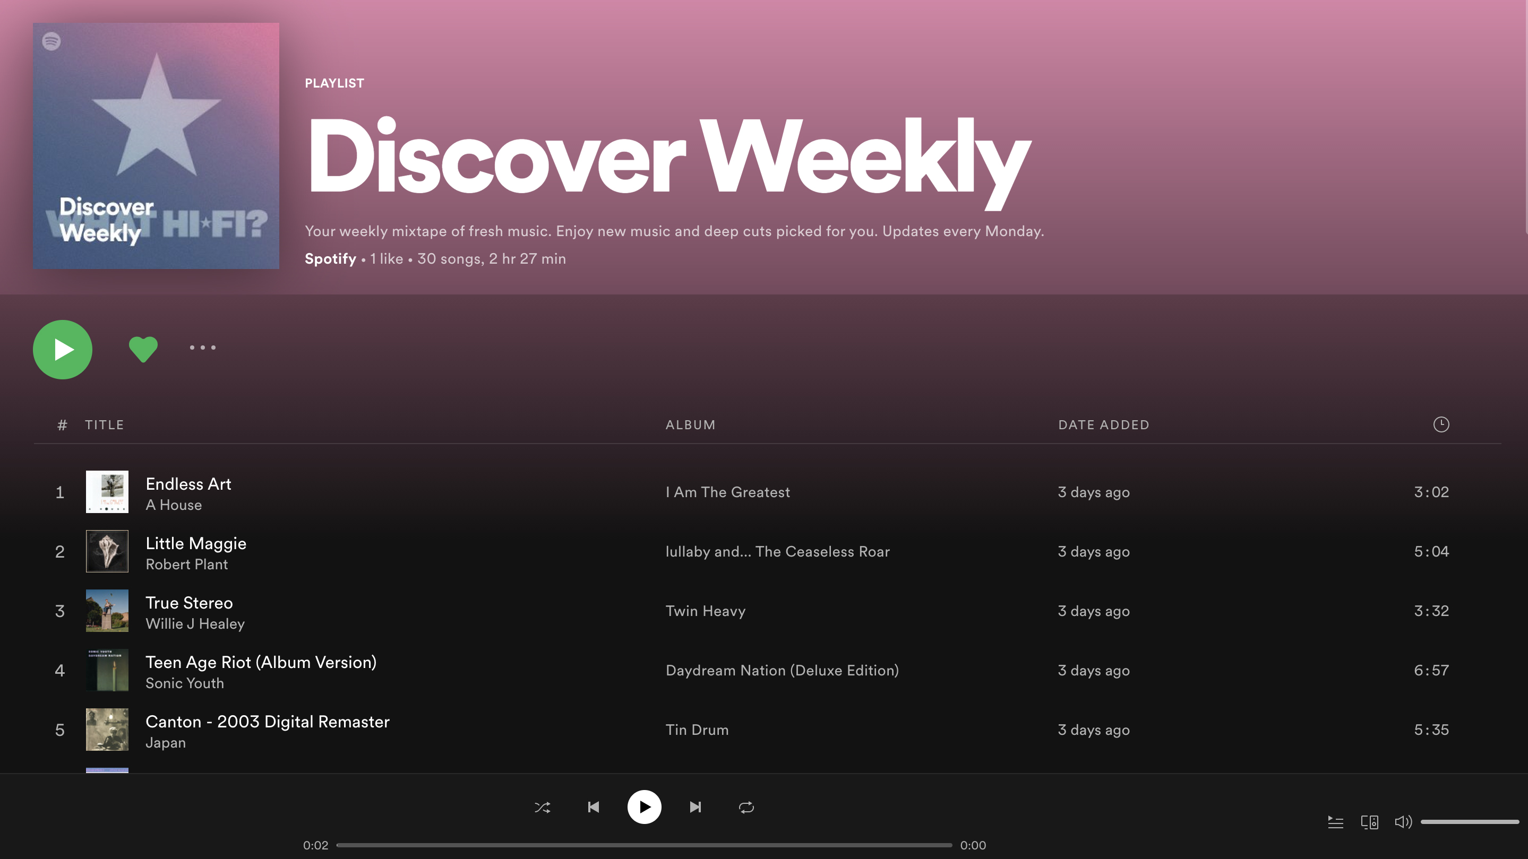
Spotify’s use of TensorFlow
One of Spotify’s most crucial feature is it’s display of created playlists and recommendations for user’s to listen to.

Slide 14
Tools
3

Slide 15

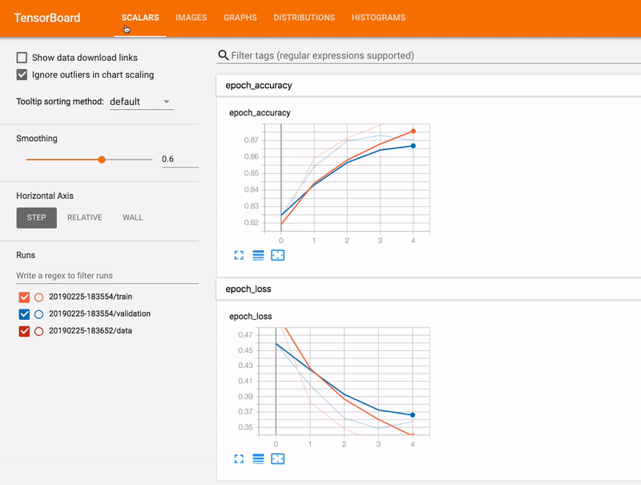
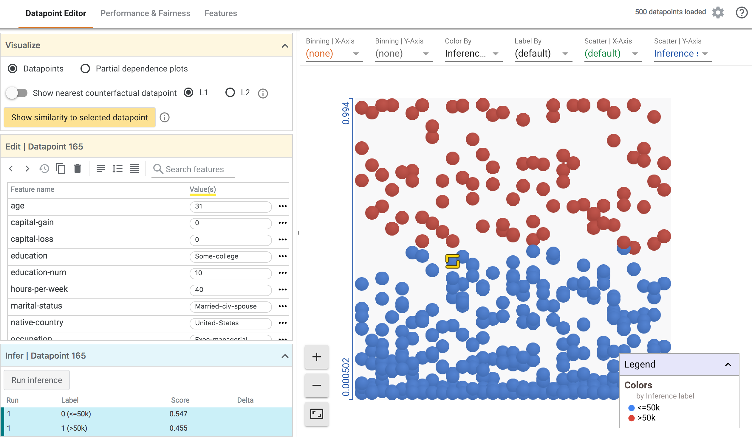
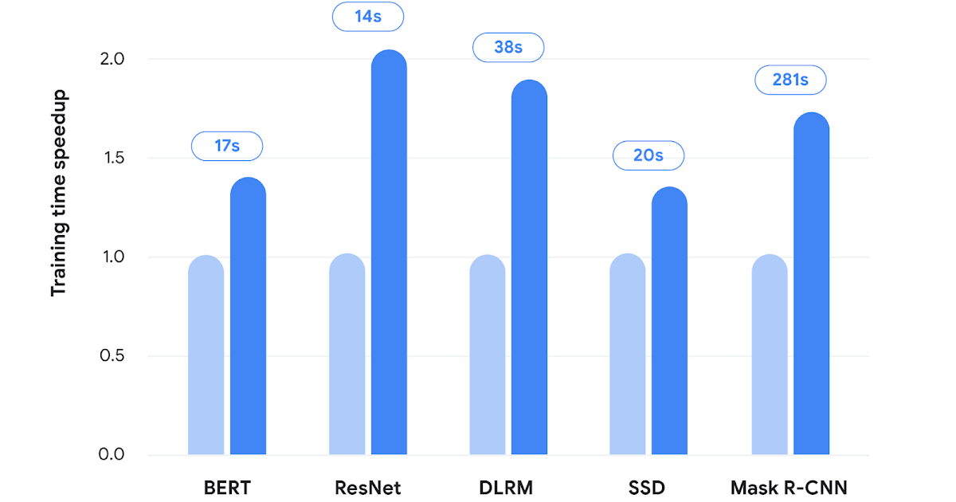
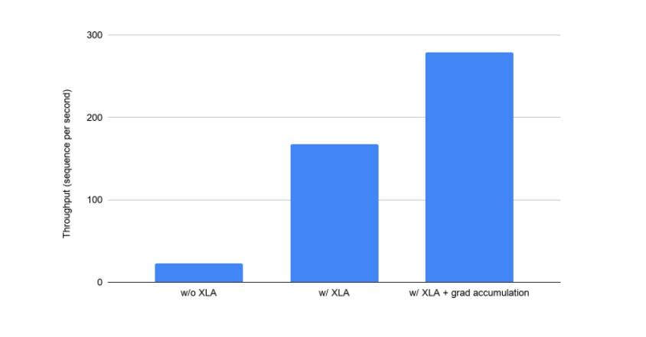
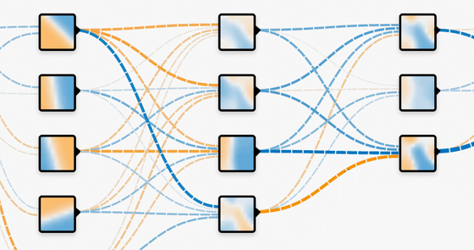

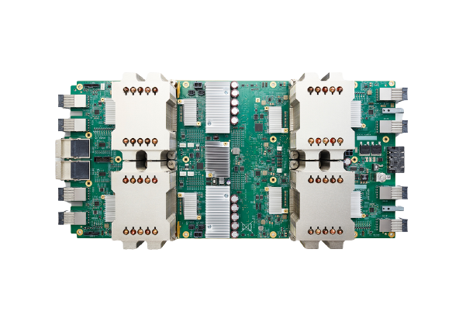
List of Tools:
Colab
TensorBoard
What-If Tool
ML Perf
XLA
TensorFlow Playground
TPU Research Cloud
MLIR
Notes:
With TensorFlow you get a huge list of Tools that any user can access to support and speed up the workflows and processes. Each Tool has its own features and particular purposes. For example in this slide I have provided 8 Tools which you can access through the actual TensorFlow website.
To start off, I will give a brief description of each one. Colab is a Tool that allows you to write and execute code within a google drive in which you can share with other user’s.
TensorBoard is a tool that provides visualizations and measurements needed during the workflow stage of machine learning. With TensorBoard, tracking experiment metrics, visualizing model graphs and projecting embeddings to a lower dimensional space are all features that it is composed of.
The What-If Tool visually probs the behaviour of trained machine learning models which is useful for debugging and understanding models
Now we have ML Perf which is a benchmark suited for measuring performance of ML software frameworks, hardware accelerators and cloud platforms
XLA or in full Accelerated Linear Algebra is a compiler which is domain-specific linear algebra to optimize TensorFlow computations. It results in improving performance in speed, memory and portability.
TensorFlow Playground is a neaural network within your browser
TPU research cloud or TRC allows researchers to speed up research breakthroughs by allowing them to access cluster of more than 1000 cloud TPU’s at no charge
MLIR or Multi-level Intermediate Representation simply an infastrcture for high-performance ML models.

Slide 16
Sharing
Free access to GPU’s
Zero Configuration
Composed of cells, each of which can be consisted of code, images and more
Connected to a cloud-based run time
Filled with code snippets to produce interactive visualizations
Notes:
Just like mentioned earlier, Colab is a Tool that allows you to write ,execute and share Python code within a google drive as well as it allows user’s to train machine learning and deep learning models on CPU’s, TPU’s and GPU’s for free! Although if you would like to experience the extended features, it would cost you 10 euro per month, the features would include more power, RAM and memory.
Why should someone use Googles Colab?
Its’s biggest feature in my opinion would be the fact that the code can be shared at any time as notebooks, I mean it does have the name of Collab after all.
It is free to use and anyone can access it. And as mentioned if you would like some extended bonuses, it would only cost 10 euro a month.
It has very user-friendly UI design that does not take long to get used to. No need to install any programs either
It provides a free Cloud Service with free access to GPU.
User’s are allowed to also Import and save the notebooks to the google drive as well as publish them to Github.
Finally it integrates OpenCV, PyTorch, TensorFlow and Keras

Slide 17
Steps
Create or import a New Notebook
Begin coding and testing
Save and share your code with other users
1
3
5
2
4
Mount it to your google drive and import libraries
Set up your Free GPU

Slide 18
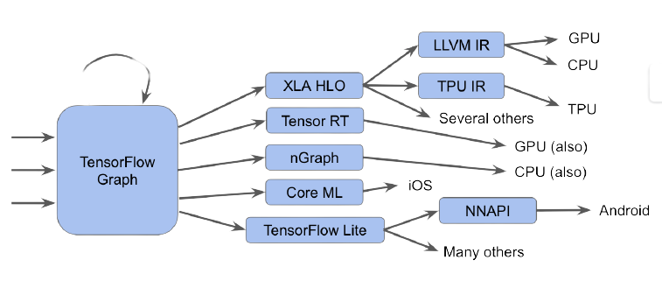
Multi-Level Intermediate Representation is responsible for creating extensible and reusable compiler infrastructure. Intended to be a hybrid IR
Dataflow Graphs
Optimizations and transformations on graphs
High-performance-computing-style loop optimizations across Kernel
Represent specified target operations
Quantization and other graph transformations
Intermediate Representation between a language (like Python) or library and the compiler backend (E.g., LLVM).
Notes:
Another tool we will divulge a bit more into is MLIR or for long Multi-level Intermediate Representation. MLIR is a tool whos purpose is to build reusable and extensible infrastructure. It is a project to support TensorFlow with different kinds of backends. It is an Intermediate Representation between a language (it can be any language) or library such as TensorFlow and the compiler Backend which in this case we will be using LLVM as the example.
It is an intended hybrid IR which supports multiple different requirements in a unified infrastructure. Some of these are:
Being able to represent dataflow graphs that developers create, these include the dynamic shapes and op eco-systems.
It provides for optimizations and transformations within graphs
Has the ability to provide high-performance-computing-style loops optimizations across kernels such as fusion and then therefore develop memory structures of data.
It represents specified target performances such as accelerator operations
And lastly it is able to quantize and transform graphs on deep-learning graphs
Although MLIR does have many more features and techniques within itself but we wont divulge into them all

Slide 19
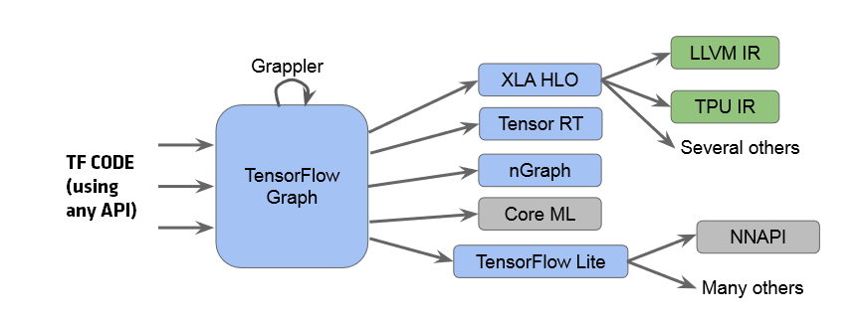
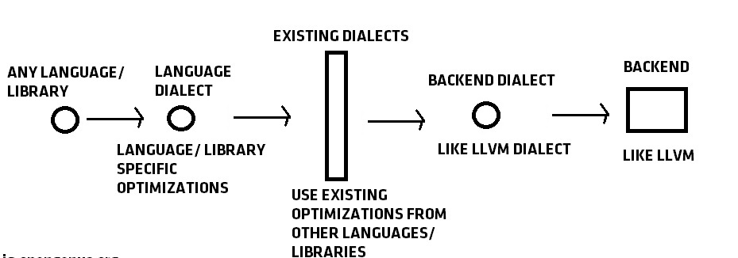
Demonstration of
Start off with a flow chart
Issue with this flow chart is that developers will have to re-implement all optimizations after each path such as XLA HLO and TensorFlow Lite
MLIR solves this issue
Same compiler infrastructure + support for a lot of backends with different IRs with no code re-use
Increases code reuse so hardware backends are supported
Captures information with flow chart and provides for better design, reuse of LLVM for code generation and it has better source code tracking
https://iq.opengenus.org/mlir-compiler-infrastructure/
Notes:
For this demonstration of MLIR it can be found at iq opengenus however I will give a summary of how it operates.
We start off with a Flow Chart which starts off with TensorFlow code using an API, we then convert it into a Graph where Grappler performs the optimizations. Then the graph is converted into several IRs for one of its backends.
The issue with this is that after each path like XLA HLO or TensorFlow Lite, developers will have to re-implement all the optimizations and code reuse will not be possible. MLIR solves this.
It has same complier infrastructure (no resue), it supports several backends that have different IR’s with no code reuse as well as it provides for bette optimizations in flexible design, resure of LLVM for code generation and it supplies for improvised source code tracking.

Slide 20
XLA (Accelerated Linear Algebra)
Domain Specific compiler for linear algebra that speeds up performance within TensorFlow Models
No source code changes required
Performance is improvised through speed and memory management
Performed either by Just-in-Time (JIT) or Ahead-of-Time (AOT)
JIT – performed to optimize graph at runtime
AOT used to generate binaries for specific architecture so that runtime + JIT compilation is not necessary
How XLA operates
Run TensorFlow program -> operations executed individually by executor -> each operation has a precompiled GPU
Kernel that it must dispatch to
XLA as an alternative method -> compilers graph into computation kernels -> developed specifically for given model
-> exploit model-specific information for optimization.
Notes:
The last Tool we will be discussing today is XLA. XLA is Accelerated Linear Algebra and as stated in the Tool description on the website, it is a domain-specific compiler that speeds up TensorFlow models with usually no source code changes necessary. It allows for performance improvisations with speed and memory usage. XLA operations can be performed in two ways, either by Just-in-Time (JIT) or Ahead-of-Time (AOT). What are these? Just in time is performed to optimize computational graphs at runtime while Ahead-of-time is utilized to generate binaries for specific architecture so that runtime and Just-in-time compilation is not necessary. Another way of putting is that the code is compiled into a machine dependant on byte code.
How does it work you may ask? When first executing a TensorFlow program, all of its operations are individually executed and each of its operations consists of a precompiled GPU kernel that the executor has to dispatch to.
XLA then steps in by providing a different method for running these models. It firstly compiles the TensorFlow Graph into a sequence of computation kernels which are created specifically for the given model. Since all these kernels are specific to the model, the exploit specific model information for optimization.

Slide 21
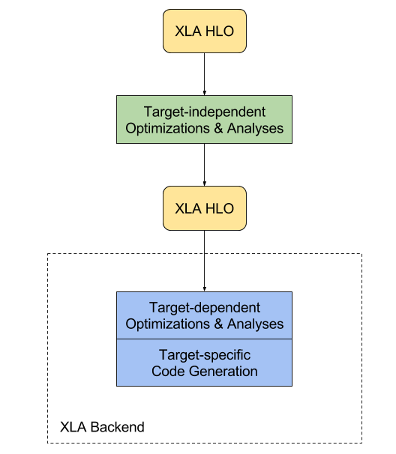
Demonstration of XLA
def model_fn(x, y, z): return tf.reduce_sum(x + y * z)
Above is the XLA Compilation process:
XLA is run through target-independent optimizations and analyses
Sends HLO to backend
Backend performs once again target-independent optimizations and analyses
Passed through target-specific code generation
Ran through three separate kernels:
Addition
Multiplication
Reduction
Whilst if to use XLA it would run by one kernel
Does this by “fusion”
Fusion – Avoids extra cycles therefore reduces memory usage and improves performance speeds.
Notes:
For a demonstration I will go over the compilation process and how XLA operates on a sample of code.
As you can see with the XLA compilation diagram, XLA is run through target-independent optimizations and analysis and once is passes through that stage it sends HLO computation to the backend where it then performs further HLO optimizations. After it is passed by target specific code generation. All the CPU and GPU backends are supported by LLVM.
Regarding the source code, without the use of XLA it is ran through three separate kernels: one for addition, one for multiplication and one for reduction.
Whilst if to use XLA, it would optimize the graph so it can compute the result through one, single kernel. How does it do this? It does this by what we call “fusing” the mathematical operations such as addition, multiplication and reduction into a single GPU kernel. XLA is composed of a very important optimization which we referred to just there, fusion. With the use of fusion, extra cycles for memory reading are avoided and therefore the removal of memory improves the performance hugely

Slide 22
Thank you for Listening
Hope you enjoyed, have a great day!
If any issues are concerned, please feel free to contact me at joao.pereira2@mail.dcu.ie

